Slide 1


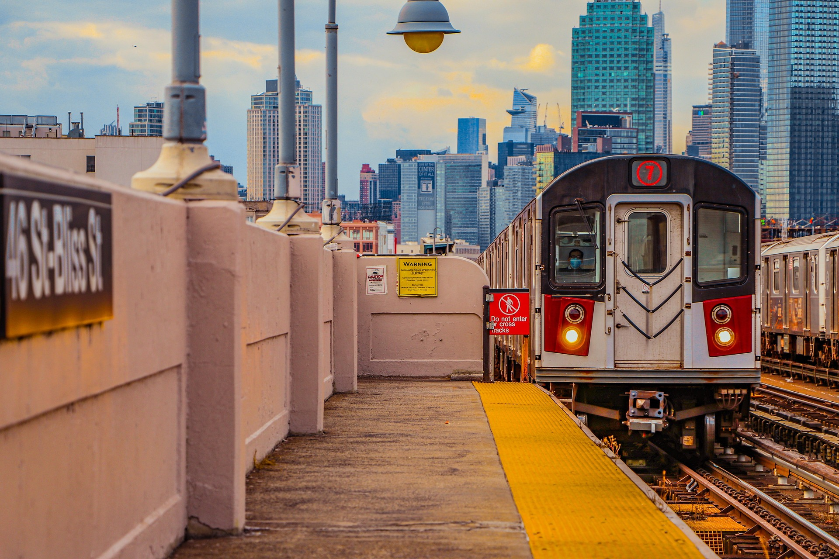
The Story of UK Railways

Slide 2

Fatma Mohamed
Ahmed Ali

Slide 3
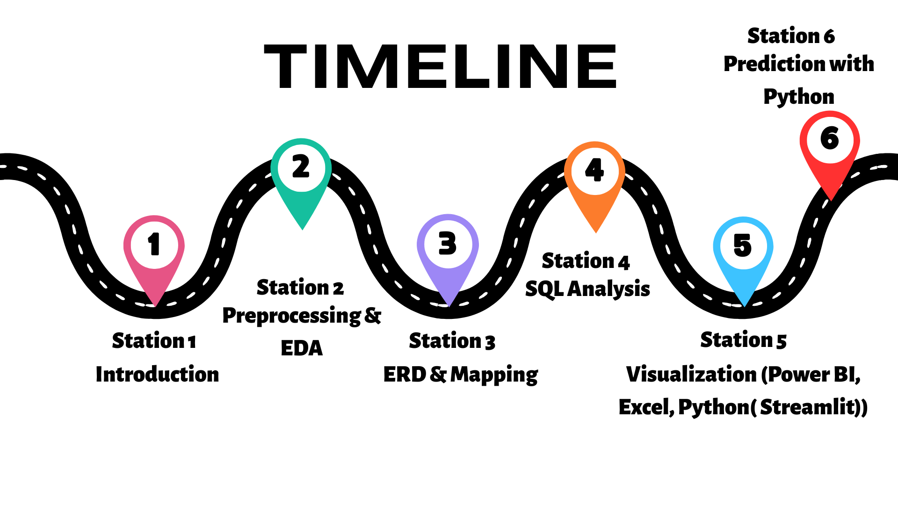

& feature engineering

Slide 4
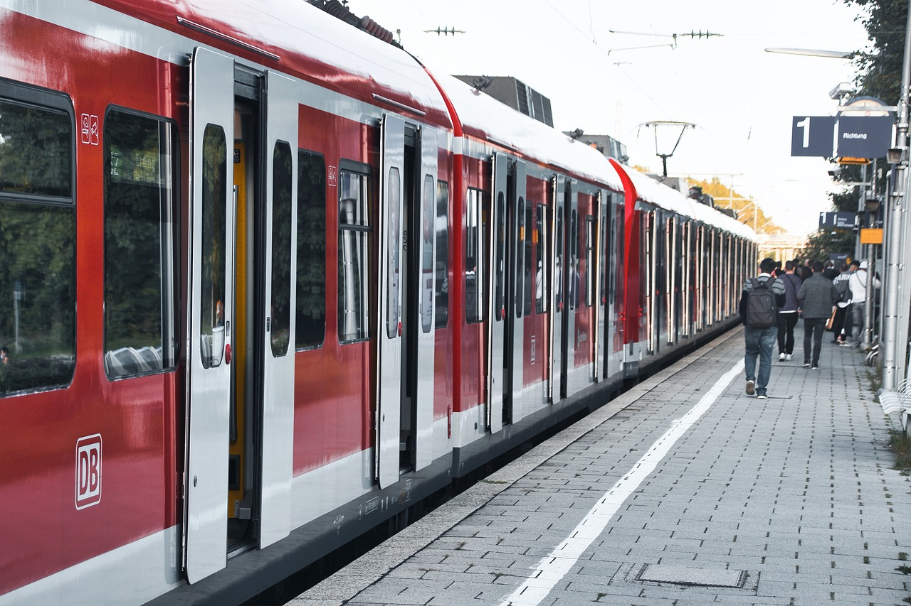





Introduction
Station 1
The dataset provided contains detailed records of railway ticket transactions over a period from January to April 2024. It includes information such as purchase details (date, time, method), ticket attributes (class, type, price), journey specifics (departure, arrival stations, times), and operational status (on time, delayed, cancelled). Additionally, it notes reasons for delays and refund requests. This data offers valuable insights into passenger travel patterns, service performance, and potential areas for improvement in railway operations. The analysis will focus on trends, delays, pricing, and customer behavior to derive actionable conclusions.

Slide 5
Preprocessing & EDA & feature engineering
Station 2
Detecting Data Type
Feature Engineering
4
creating new features
from our raw data
Route between Depature ana arrival station
calculate Duration
Month of Purchase
Purchase Hour
Departure _ Hour
Departure _ Day
detect and correct the data type of the time and date column. To ensure accurate time-based analysis, I converted the values into the proper datetime format.
Resolving Duplicates
Handled Missing
Replaced weather condition with weather , Standardized Single failure to Single Failure
ensure data consistency and improves the quality of the analysis.
Imputed missing values for on-time trips with no_delay and no_cancelation , and used "no arrival" for canceled trips lacking arrival times.

Slide 6
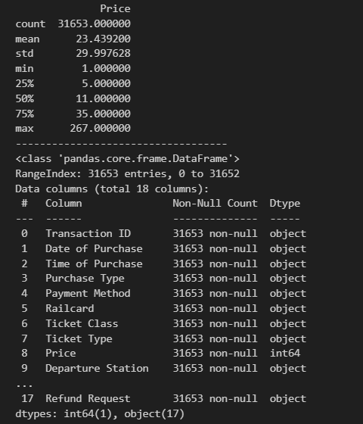
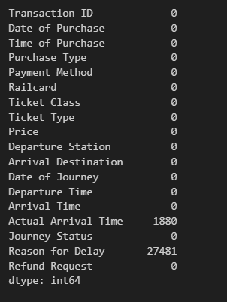




Station 2
EDA (Python)

Slide 7
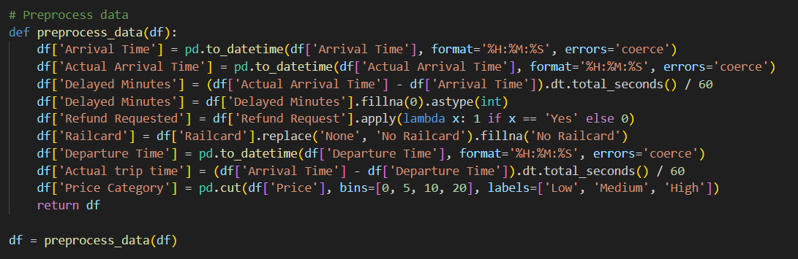
Data Preprocessing (Python)

Slide 8

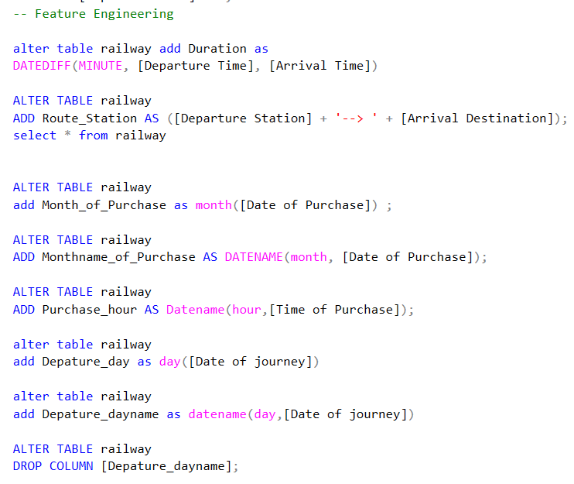
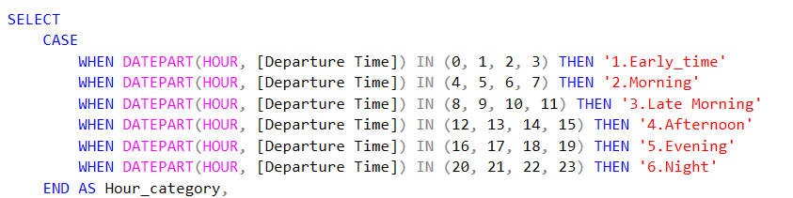
Feature Engineering (SQL)

Slide 9
ERD & Mapping
Station 3
I designed the ERD (Entity Relationship Diagram) and performed data mapping for the project. To Clearly visualizes the structure and relationships between tables
Makes database design more organized and easy to understandSimplifies integration between different systems or sources

Slide 10
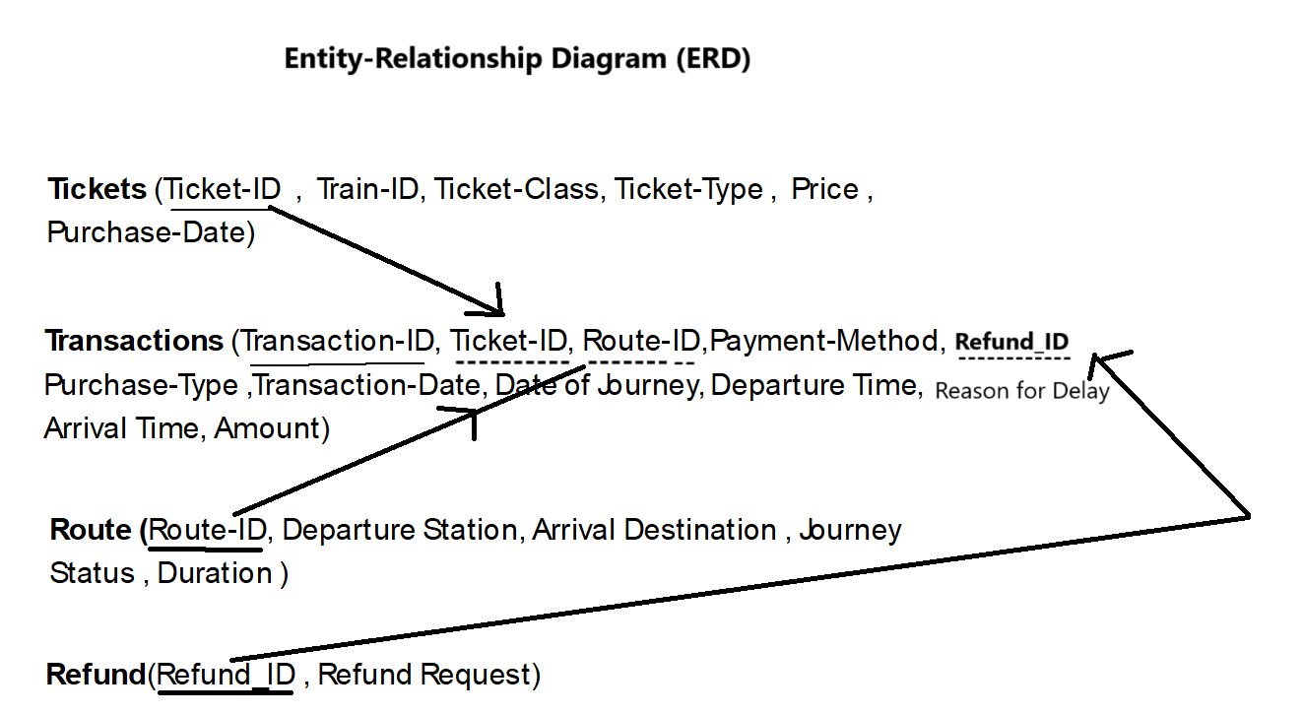
ERD
ERD

Slide 11
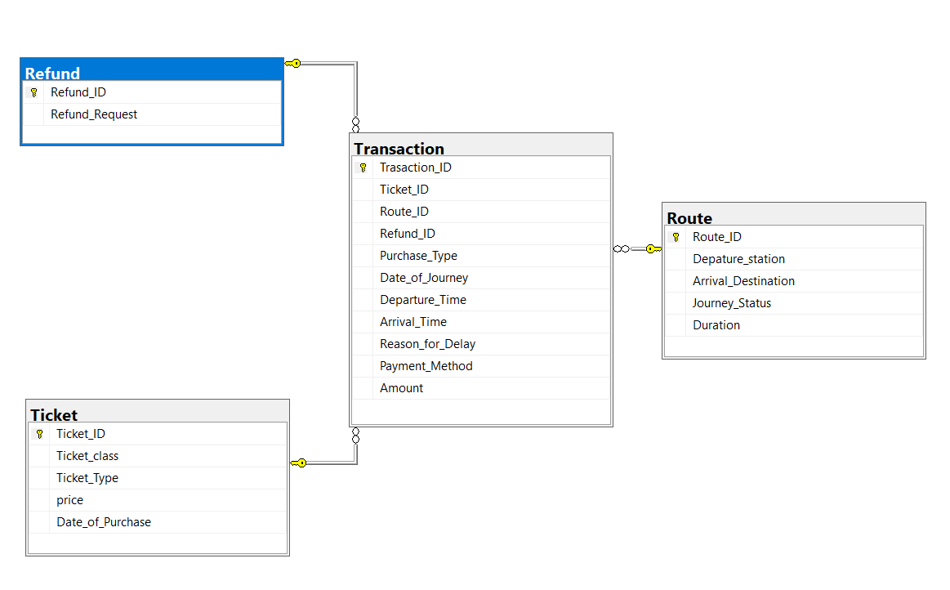
Mapping

Slide 12
SQL Analysis
Station 4
What is the total ticket purchased?
2. Calculate Duration
3. Where do they purchase the tickets and how do the pay for it?
4. What is Peak Time Rides?
5. Where were the top tickets sold and by which payment_method?
6. reason for Delay
7. how often are the rides
8. what is total REV , NET REV , Loss REV
9. what is percentage of the loss REV was due to delay ,cancelled ?
10. what is reason for Delay
answer important questions

Slide 13
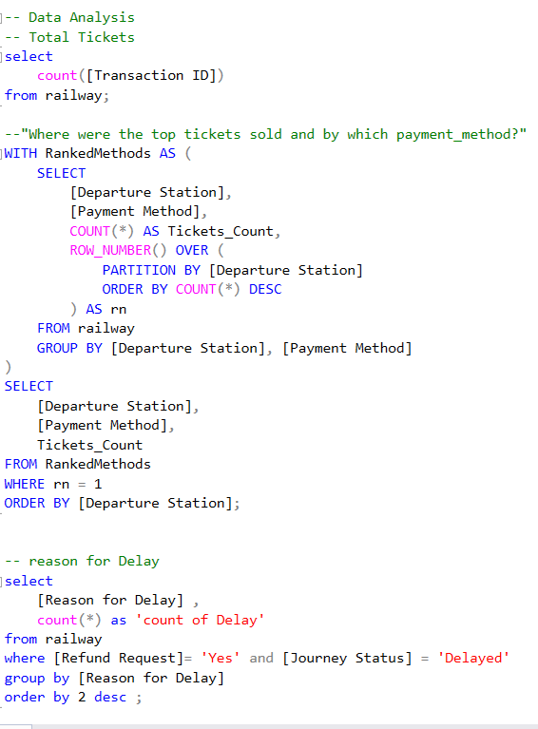
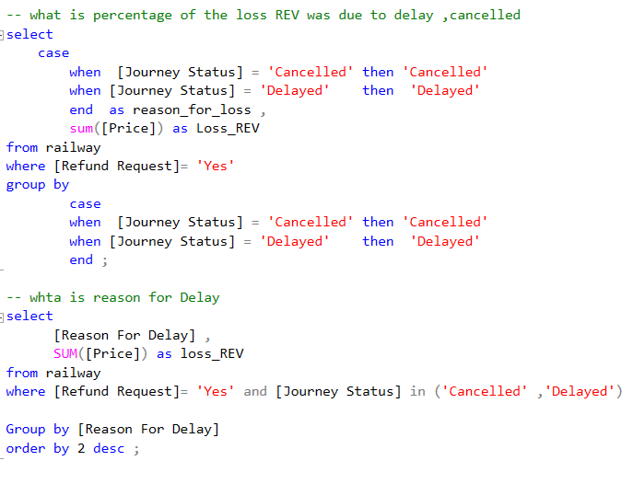
Queries

Slide 14
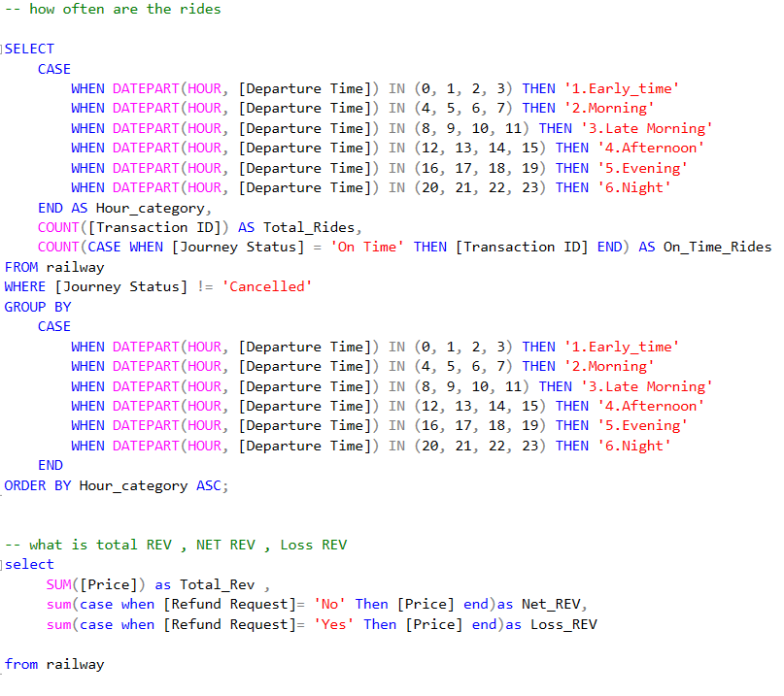
Queries 2

Slide 15
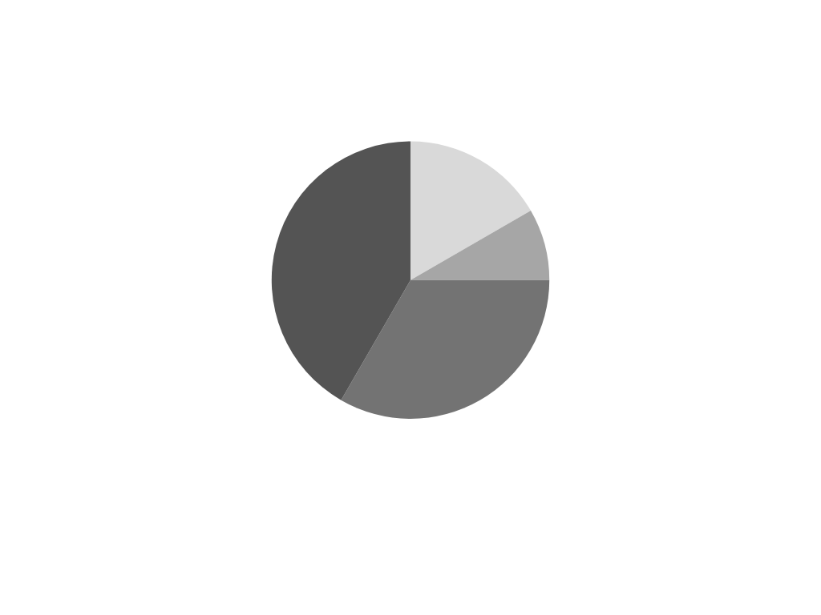


Visualization (Power BI, Excel, Python( Streamlit))
Station 5
Analysis Dashboards: Power BI, Excel, Python — Presented using Streamlit for interactive insights provided through the Railway UK project
Overview of the core areas of analysis: Route, Delays, Railway Overview, Operational Performance, Customer Behavior, and Customer Satisfaction & Refunds
Performance insights enable effective performance analysis, allowing stakeholders to make informed decisions.

Slide 16

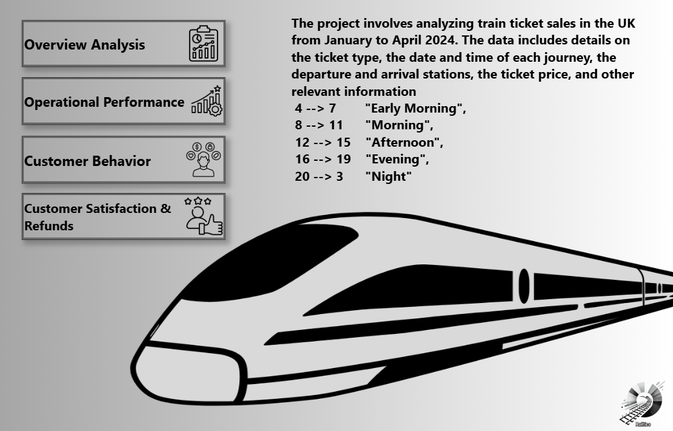
Power BI Dashboard

Slide 17
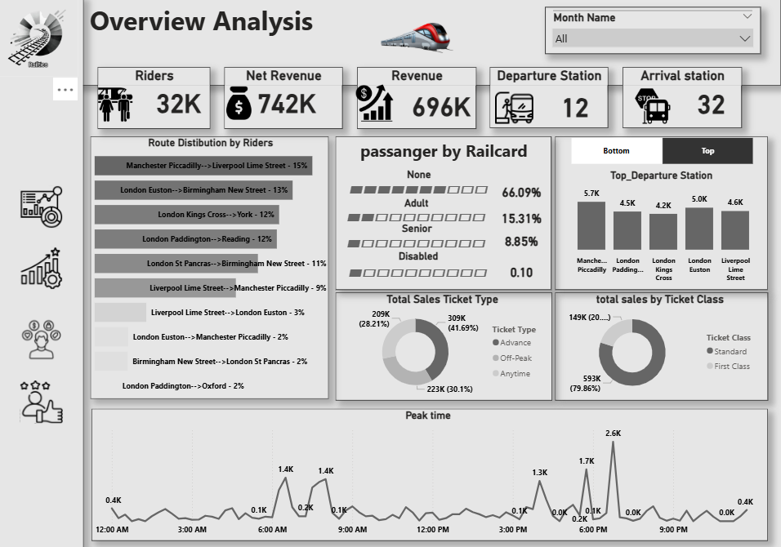

Slide 18
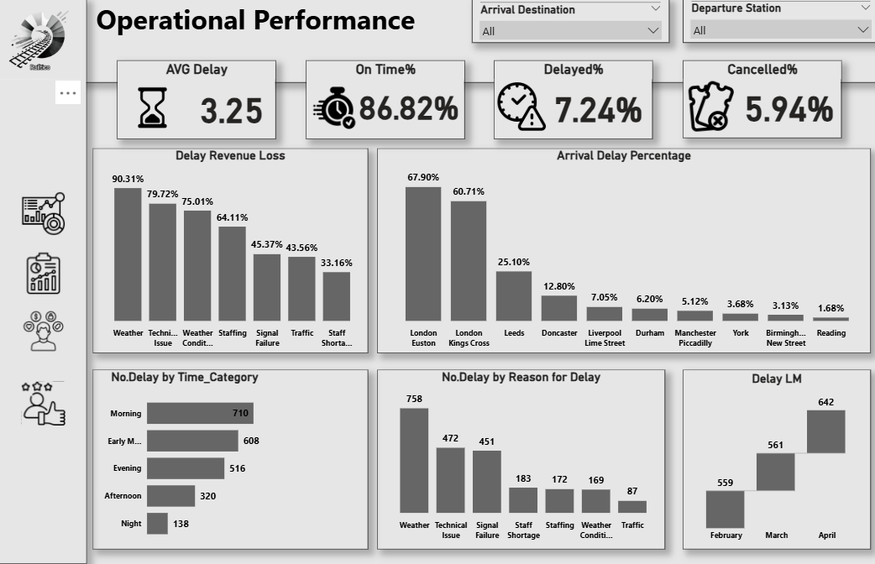




Slide 19
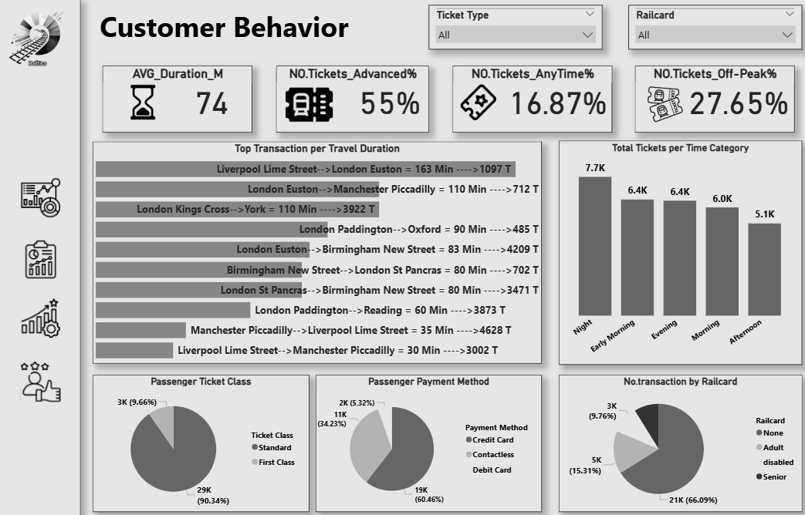




Slide 20
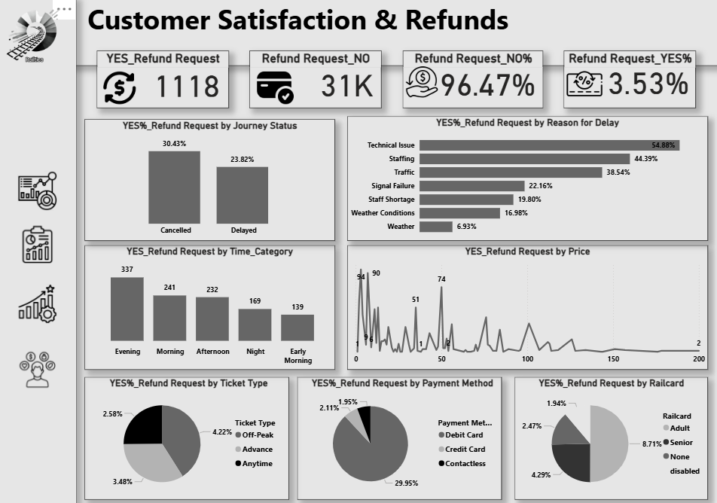




Slide 21
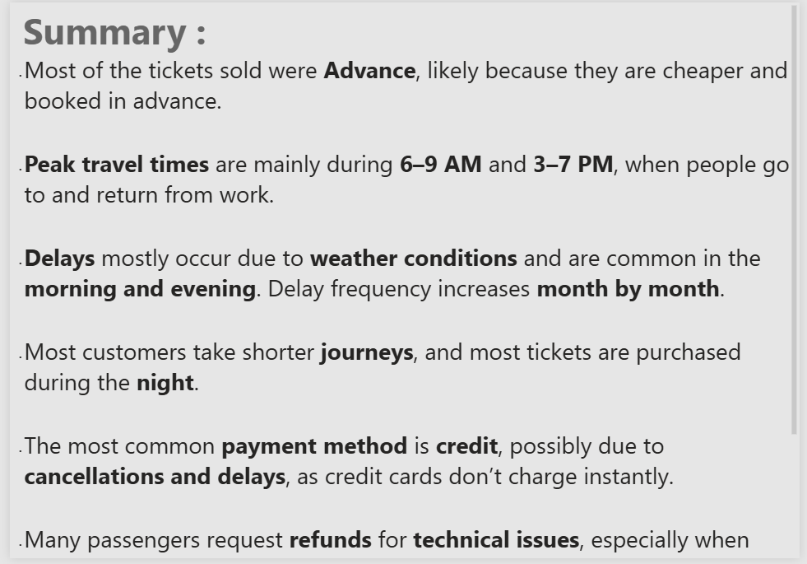

Slide 22
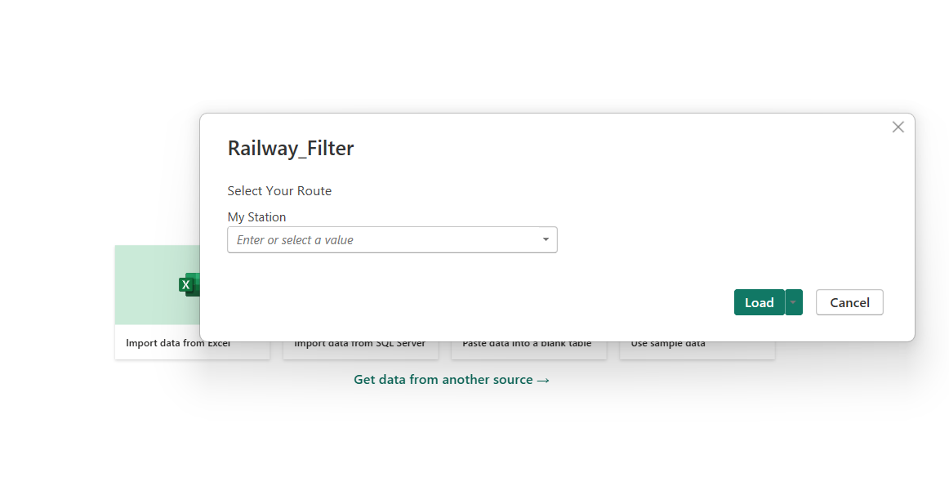
Power BI Filter

Slide 23
You can view the interactive Power BI dashboard from the following link :
https://app.powerbi.com/view?r=eyJrIjoiNDkyZjBmZjItYWEwZC00NDIyLWFiMWYtMjBkNjhlNTk2Yzg2IiwidCI6IjhmY2Y0Y2Q5LTJmZTQtNDU3MS04NDMxLWIxN2MzZjI5ZWZiMyJ9&pageName=7495c27e99088e81bb64

Slide 24
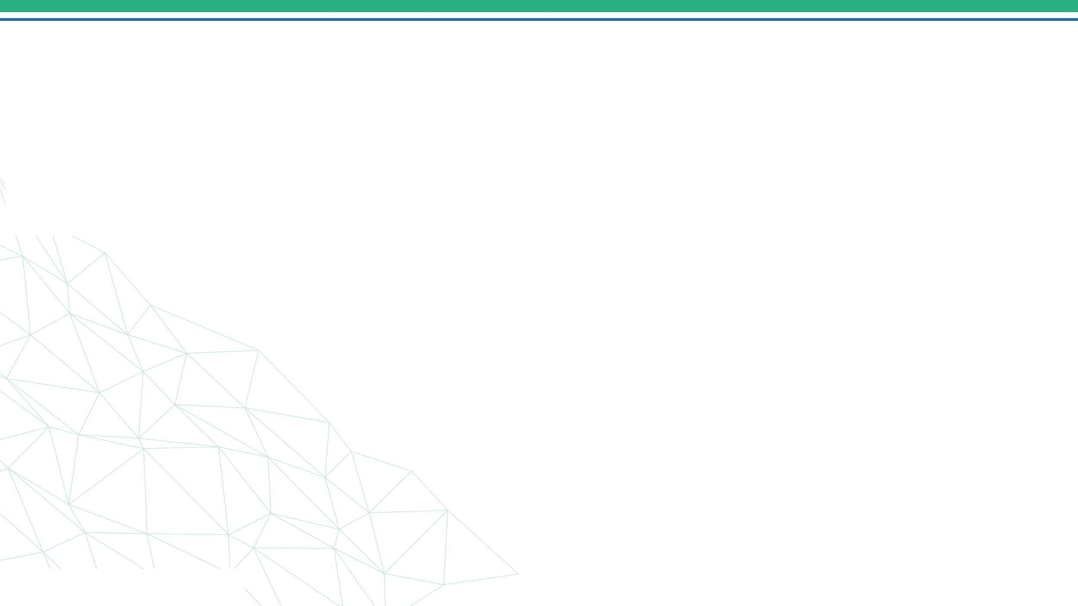


Dashboard using Python
I performed the analysis using Python and presented the results using Streamlit. The analysis included:
🎟️ Refund Rate by Railcard Type
🪑 Refund Rate by Ticket Class
🛒 Refund Rate by Purchase Type
💷 Price vs Delay
📊 Refund Rate by Price Category
🕒 Top Delay Reasons
Average Delay (minutes)
Refund Request Rate
Average Ticket Price (£)

Slide 25
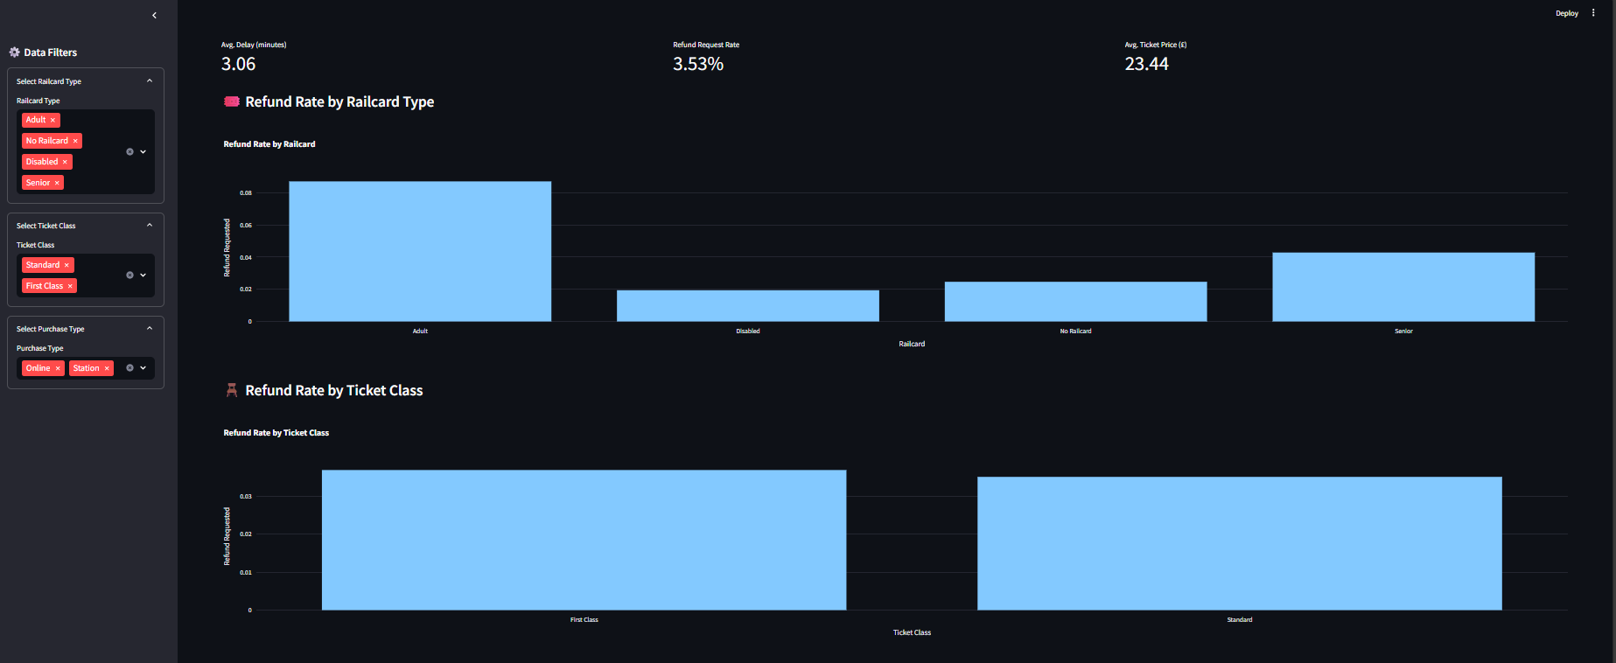

Slide 26
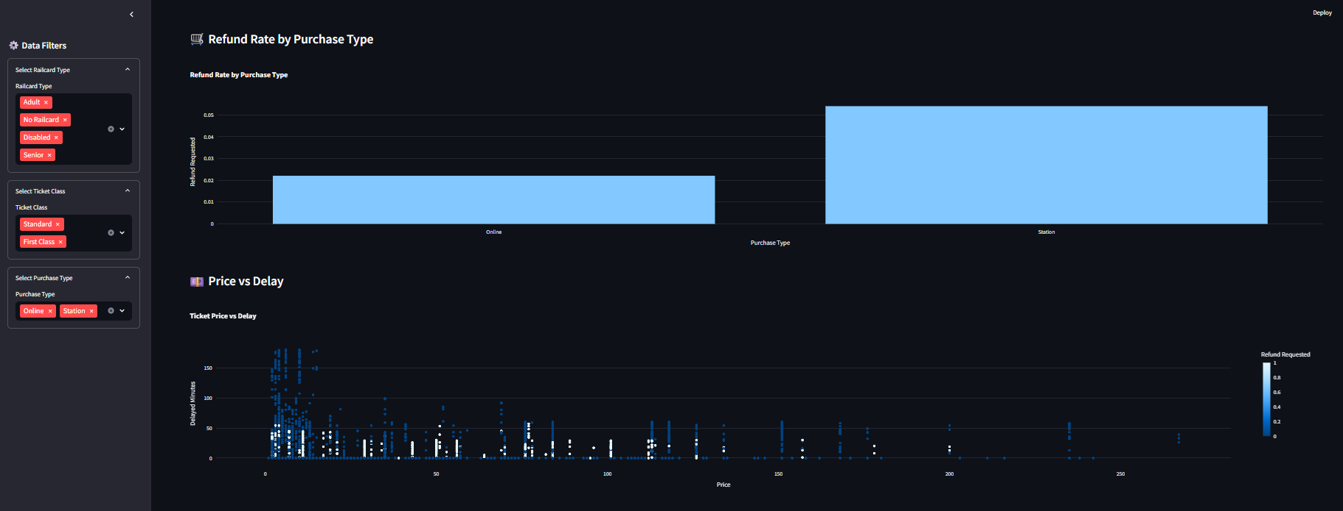
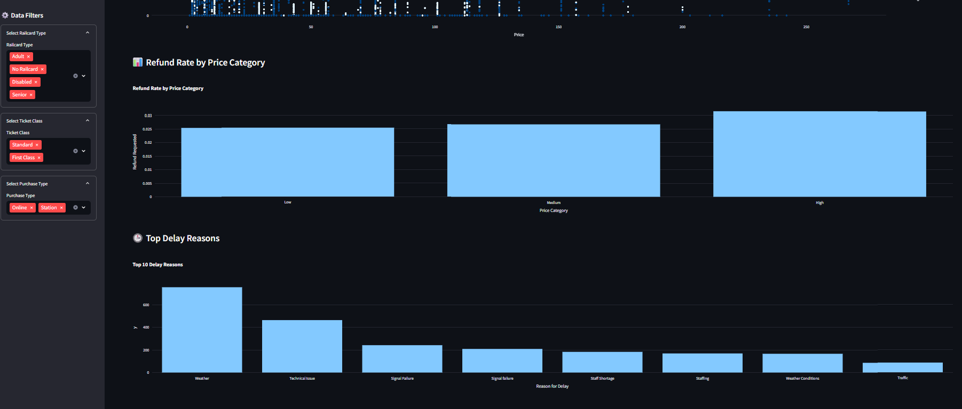

Slide 27
The Final Stop
Prediction with
Python
Model Overview
I used a Random Forest Classifier to predict whether a passenger will request a refund or not
Features (Model Inputs)
The model uses the following input features:
Purchase Type , Payment Method ,Railcard ,
Ticket Class , Ticket Type ,Price , Departure Station and Arrival Destination
All categorical inputs were encoded using One-Hot Encoding to prepare them for the model.
Target Variable (Model Output)
The target is Refund Requested:
The model predicts the probability of refund request. If the probability is greater than 50%, the system predicts "Yes", otherwise "No".

Slide 28
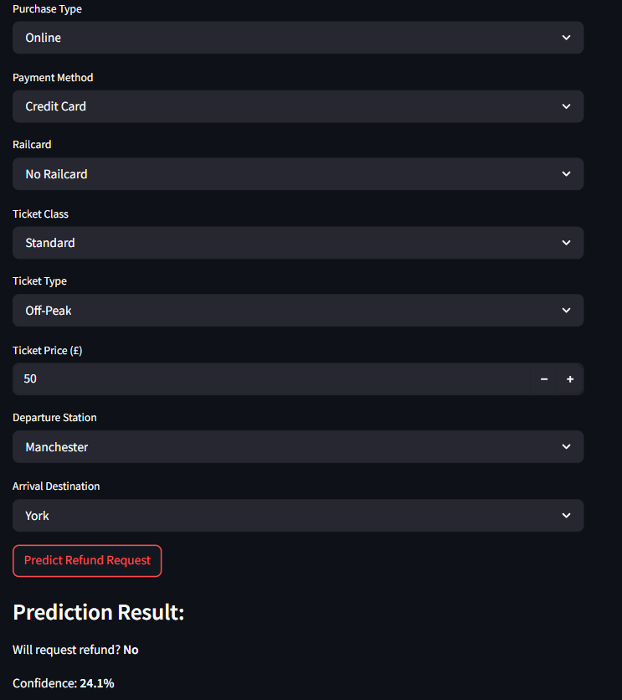

Slide 29

GitHub :
GitHub - omar3lii/Pro-DEPI

Slide 30
Thank You

